Slide 1
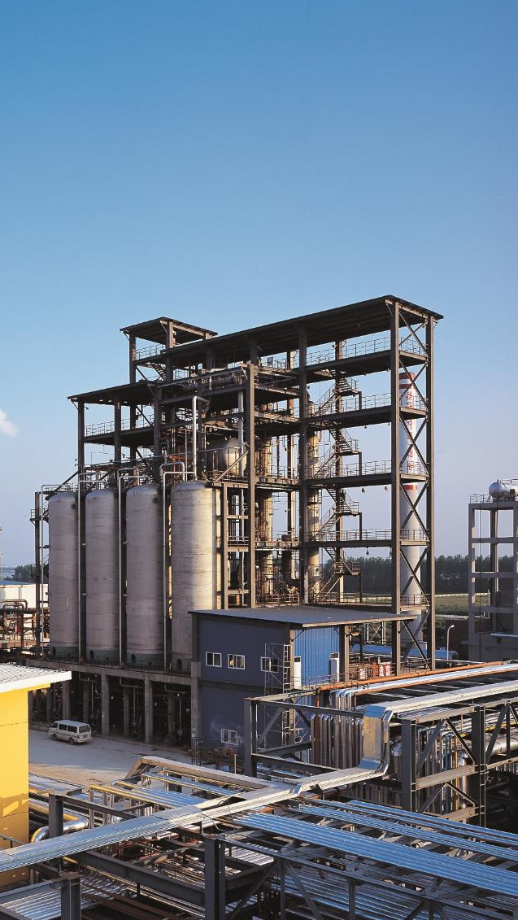


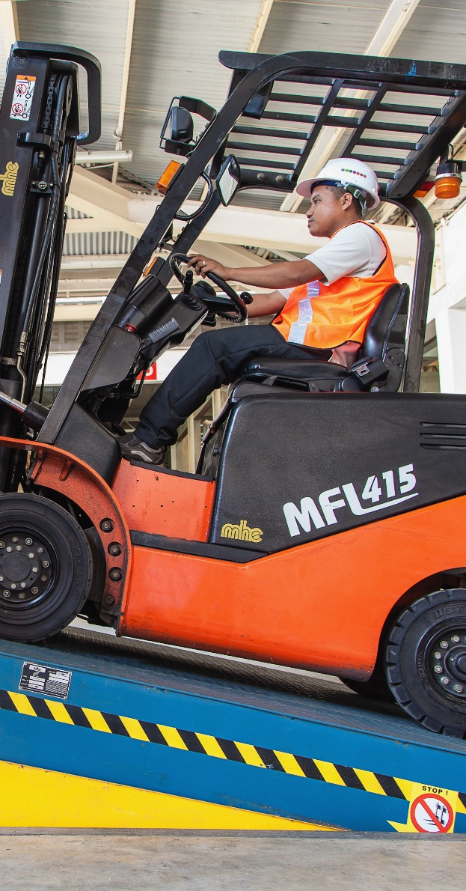
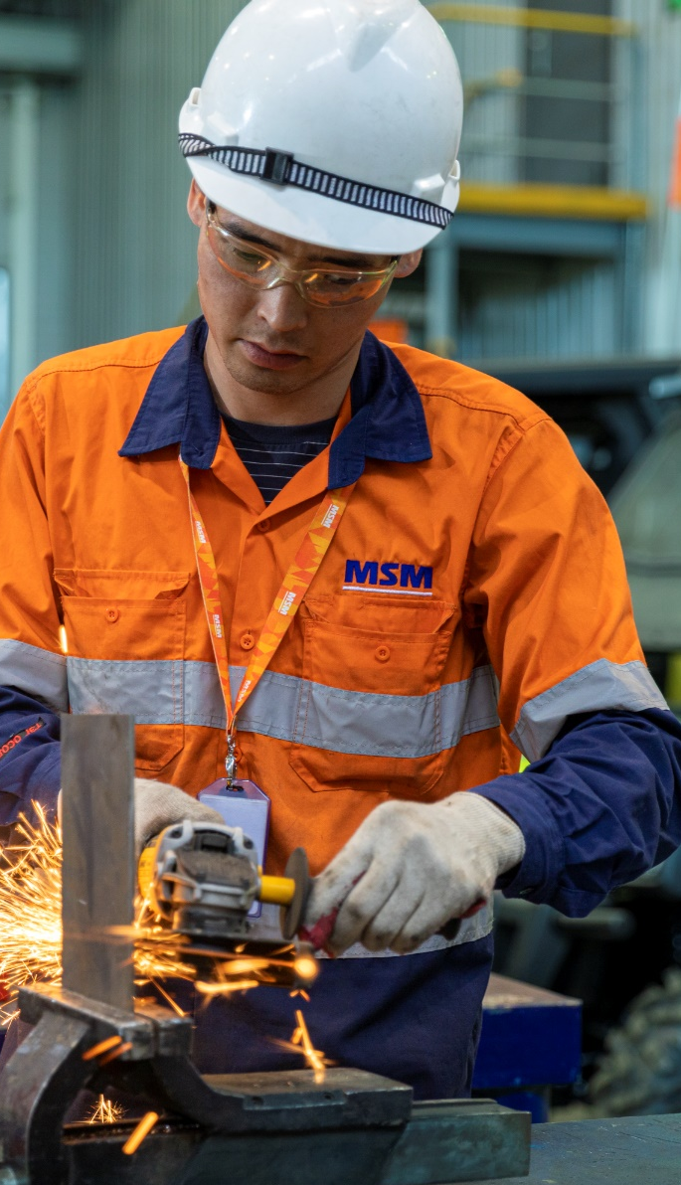
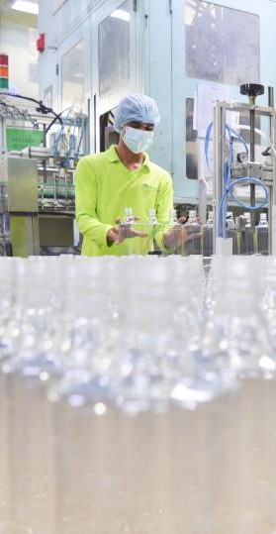

CORPORATE PRESENTATION 2026

Slide 2
CONTENTS
Purpose
Values
Businesses
Management
Sustainability
The Family Enterprise

Slide 3

OUR PURPOSE
We enable sustainable industrial development with an eye on new opportunities in tomorrow’s markets.
WHO WE ARE
At Jebsen & Jessen Group, we build upon our distinctive heritage as a trusted provider of quality industrial products and value-added solutions, with a strong commitment to partner and grow with our customers in a sustainable manner.

Slide 4





OUR VALUES SERVE AS OUR COMPASS…
Trust
Entrepreneurship
Prudence
Commitment
Partnership

Slide 5






OUR BUSINESSES
7 BUSINESS UNITS
INDUSTRIAL ENGINEERING
INDUSTRIAL GARNET
INGREDIENTS
MATERIAL
HANDLING
MOBILITY, INDUSTRY & BEVERAGE
PACKAGING
TECHNOLOGY
Building Access Systems
• Cranes & Components
• Equipment Maintenance & Servicing
• Industrial Services
Warehouse Solutions & Automation
• Methylester (Biodiesel)
• Edible Oil Refining
• Fats Modification
• Oilseed Extraction
• Oleochemicals
• Abrasive Blasting
• Waterjet Cutting
• Coating & Resins
• Feed
• Food
• Performance Chemicals
• Personal Care
• Pharmaceuticals
• Plastics & Rubber
• Automotive
• Beverage
• Industrial
• Bottles & Jars
• Engineered Foam
• Foam Components
• Protective Packaging
• Offshore & Marine Cables
• Pumps
• Turf & Irrigation

Slide 6


GLOBAL PRESENCE
AUSTRALIA
16 countries
BRAZIL
CHINA
GERMANY
>4,000 employees
INDIA
INDONESIA
20 manufacturing, mining and processing facilities
MALAYSIA
MONGOLIA
MYANMAR
SGD 1.6bn turnover
PHILIPPINES
SAUDI ARABIA
SINGAPORE
SGD 1.8bn assets
THAILAND
UNITED ARAB EMIRATES
UNITED STATES
VIETNAM
Notes:
With the acquisition, the numbers will increase substantially:
4,000 employees
50,000 customers

Slide 7

INDUSTRIAL ENGINEERING
190
people
turnover
S$240m
Methylester (Biodiesel)
Edible Oil Refining
Fats Modification
Oilseed Extraction
Oleochemicals
Brazil | China |
Germany | India | Indonesia | Malaysia

Slide 8
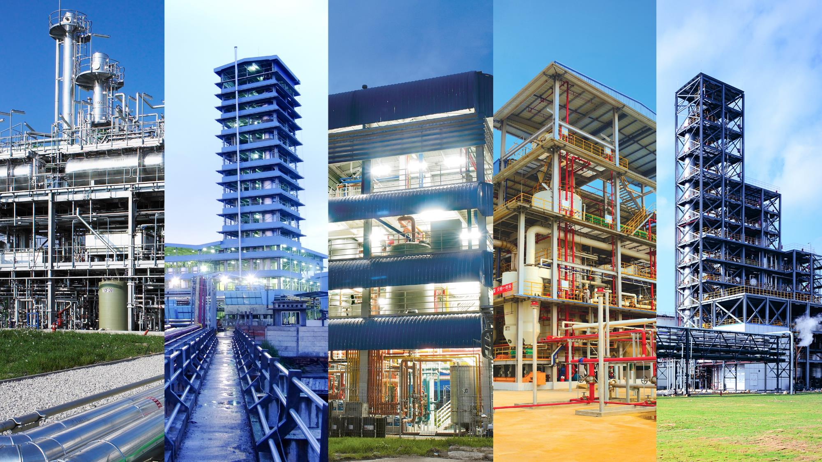

37
people
Indonesia | Malaysia
Philippines | Singapore
Thailand | Vietnam
Methylester (Biodiesel)
Edible Oil Refining
Fats Modification
Oilseed Extraction
Oleochemicals

Slide 9
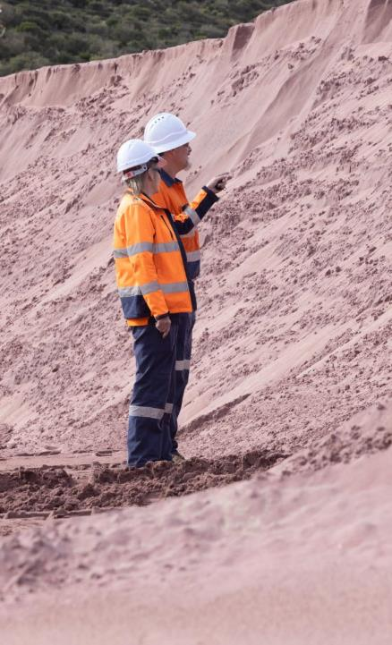

INDUSTRIAL GARNET
460
people
turnover
S$280m
Abrasive Blasting
Waterjet Cutting
Australia | Saudi Arabia | United Arab Emirates | United States

Slide 10
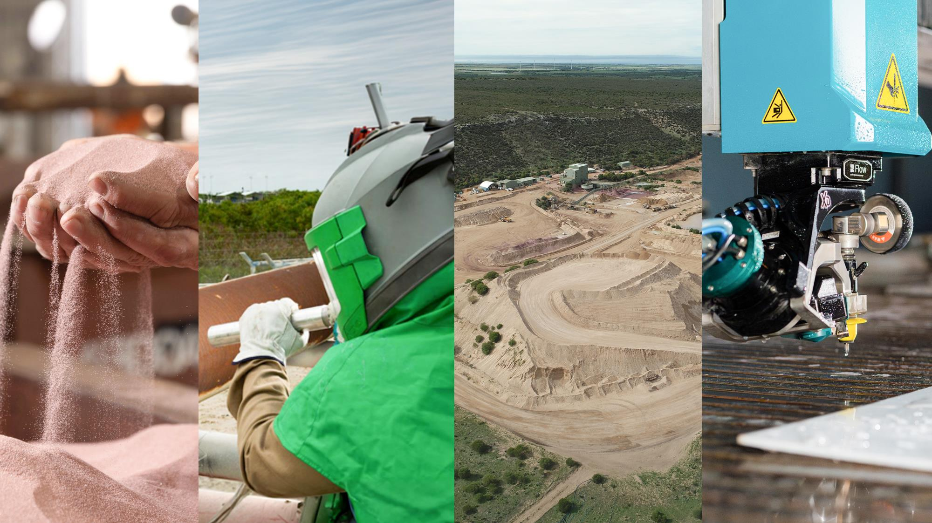
37
people
Indonesia | Malaysia
Philippines | Singapore
Thailand | Vietnam
Abrasive Blasting
Waterjet Cutting

Slide 11


INGREDIENTS
270
people
Coating & Resins
turnover
Feed
S$280m
Food
Performance Chemicals
Indonesia | Malaysia | Myanmar | Philippines | Singapore | Thailand | Vietnam
Personal Care
Pharmaceuticals
Plastics & Rubber

Slide 12

37
people
Indonesia | Malaysia
Philippines | Singapore
Thailand | Vietnam
Coating & Resins
Feed
Food
Performance Chemicals
Personal Care
Pharmaceuticals
Plastics & Rubber

Slide 13
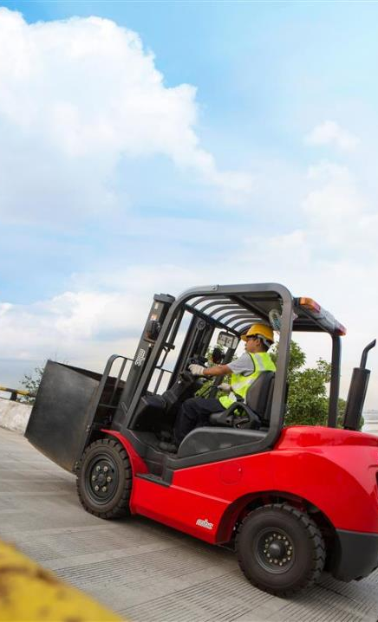

MATERIAL
HANDLING
560
people
Building Access Sytems
turnover
Cranes & Components
S$170m
Equipment Maintenance
& Servicing
Industrial Services
Australia | China | Indonesia | Malaysia | Philippines | Singapore Thailand
Warehouse Solutions
& Automation

Slide 14
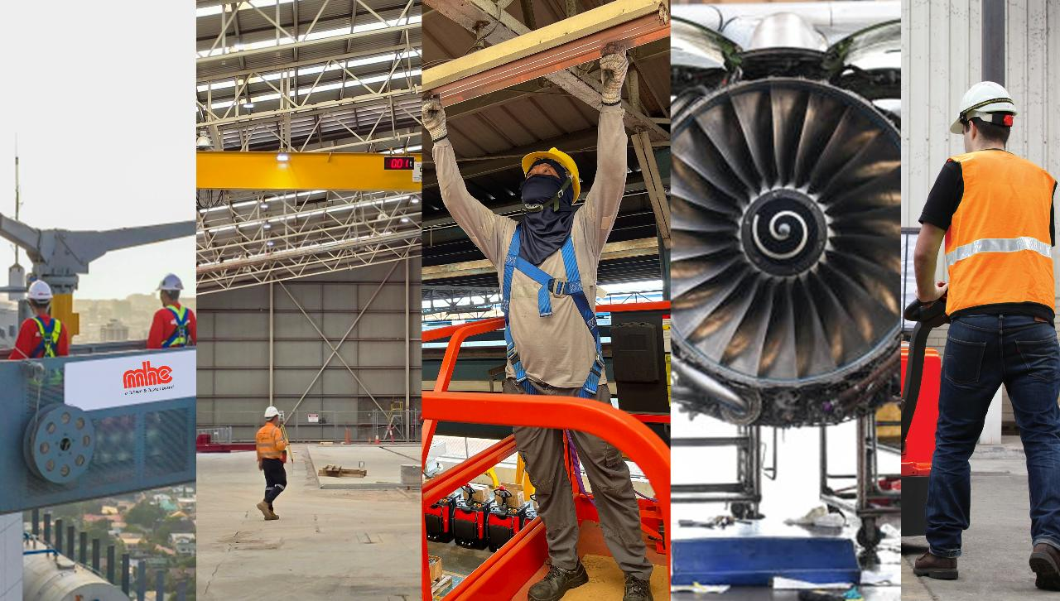
37
people
Indonesia | Malaysia
Philippines | Singapore
Thailand | Vietnam
Equipment Maintenance & Servicing
Building Access Systems
Cranes & Components
Industrial Services
Warehouse Solutions & Automation

Slide 15
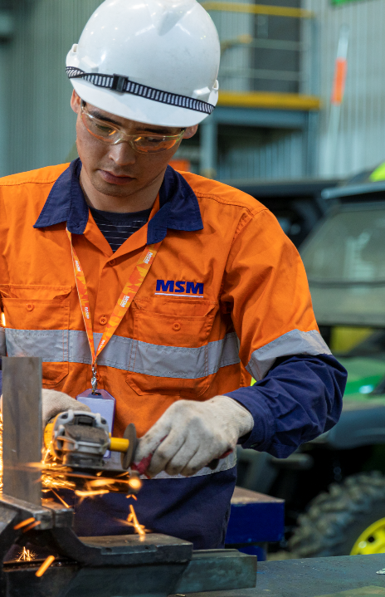
MOBILITY, INDUSTRY & BEVERAGE
850
people
turnover
S$300m
Automotive
Beverage
Industrial
Mongolia

Slide 16

37
people
Indonesia | Malaysia
Philippines | Singapore
Thailand | Vietnam
Automotive
Beverage
Industrial

Slide 17
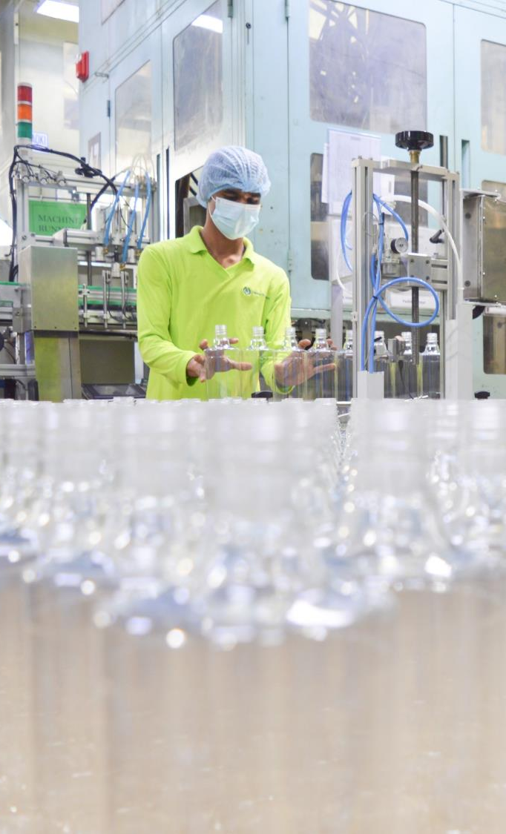
PACKAGING
1,270
people
Bottles & Jars
turnover
Engineered Foam
Foam Components
S$130m
Protective Packaging
Indonesia | Malaysia | Singapore | Vietnam

Slide 18

Bottles & Jars
Engineered Foam
Foam Components
Protective Packaging

Slide 19


TECHNOLOGY
230
people
Offshore & Marine Cables
Pumps
Turf & Irrigation
turnover
S$150m
Indonesia | Malaysia | Myanmar | Philippines | Singapore | Thailand | Vietnam

Slide 20
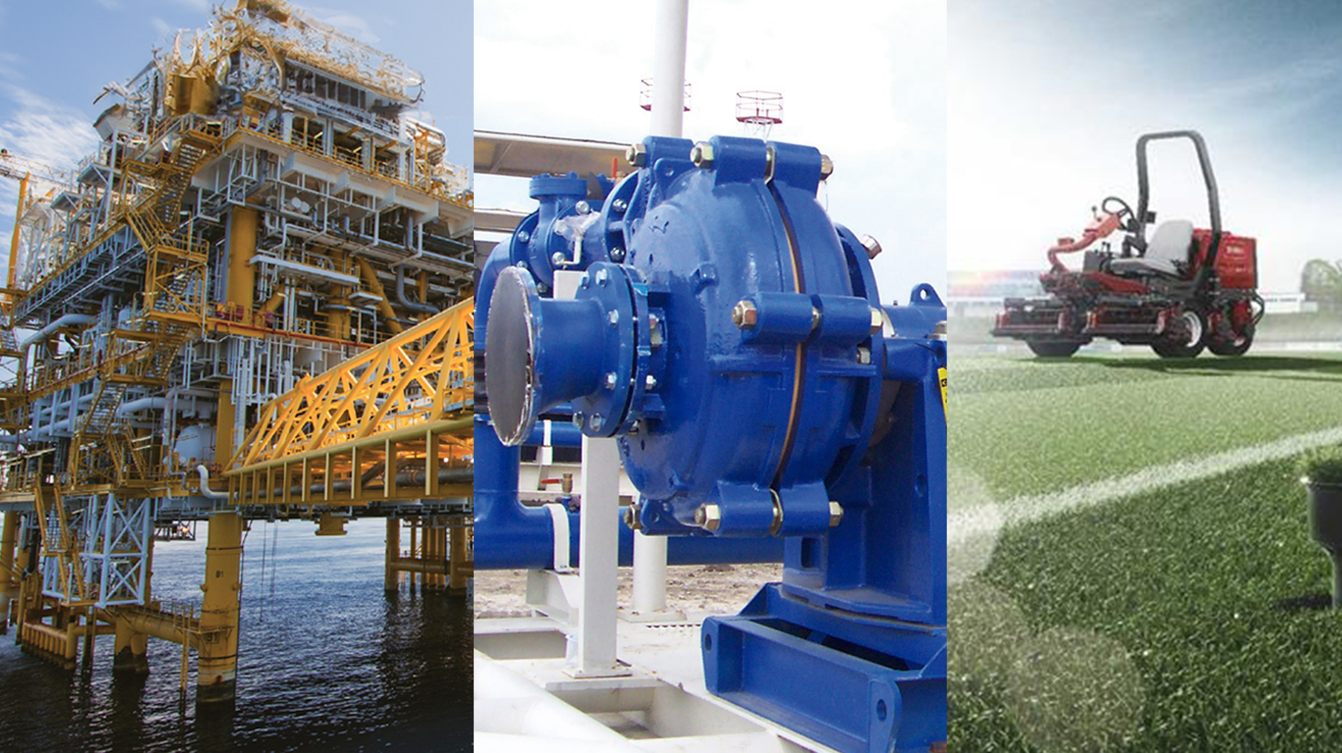
37
people
Indonesia | Malaysia
Philippines | Singapore
Thailand | Vietnam
Offshore & Marine Cables
Pumps
Turf & Irrigation

Slide 21

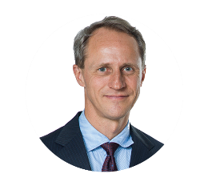
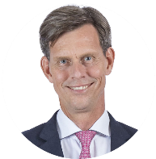
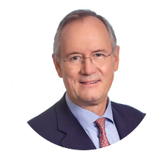

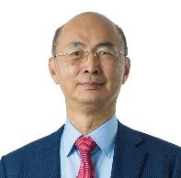
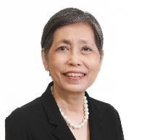
BOARD OF DIRECTORS
Chui Tau Siong
Euleen Goh
Hans Michael Jebsen
Heinrich Jessen
Per Magnusson
Fritz Graf von der Schulenburg
Elaine Yew

Slide 22
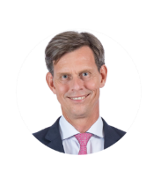




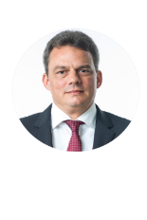



EXECUTIVE MANAGEMENT TEAM
Per Magnusson
Group CEO
Lim
Siew Tin
CEO
Ingredients
Chang
Chee Keong CEO
Packaging
Martin Overgaard Hansen
CEO
Industrial Engineering
Stephan Kirsch
CEO
Industrial Garnet
Karl
Tilkorn
CEO
Material
Handling
Mark
Gabel
CEO
Mobility, Industry & Beverage
+
CEO
Technology
Viktor Leendertz
Group CFO
Jebsen & Jessen
Olivia
Chua
Group CHRO
Jebsen & Jessen

Slide 23
CORPORATE TEAM
Executive Board
Group Chief Human Resources Officer
Group Chief Financial Officer
Corporate Communications
Group ITC
Group Finance & Treasury
Group Corporate & Legal Affairs
The HUB
Group Audit & Taxation
Rewards
Development
Credit & Cash Management
HRIS
IT Support & Admin
Account to Reporting
Talent
Network Support & Admin
Country HR Teams
SAP Support

Slide 24

SUSTAINABILITY

Slide 25
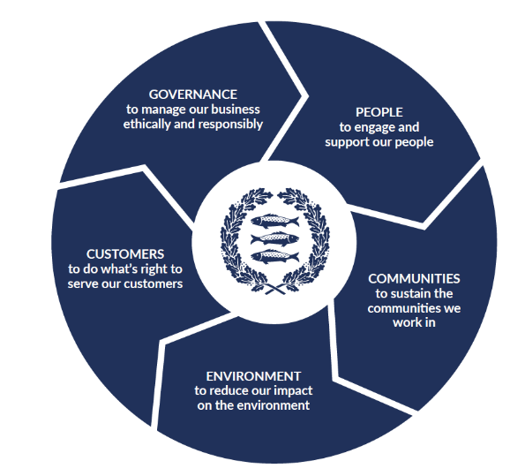


SUSTAINABILITY SNAPSHOT
In 1995, our ‘Environment, Health & Safety’ (EHS) department was implemented for the whole group.
In 2001, it became mandatory for every company to be certified to the globally-recognised ISO14001 and ISO45001 standards.
In 2011, we became the first industrial company in South East Asia to become carbon neutral.
In 2022, we published our first Sustainability Report:

Slide 26

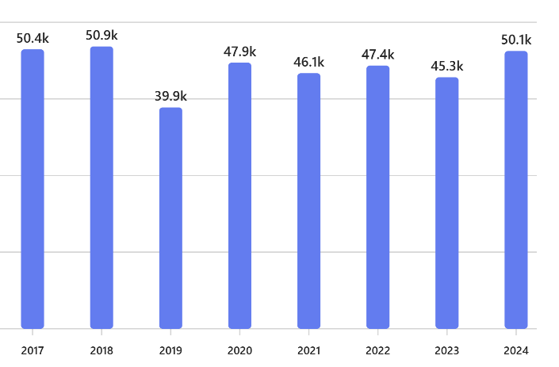
CARBON NEUTRALITY PROGRAMME
We have offset over 640,000 tonnes of CO2 emissions since 2011
Various emission reduction initiatives including:
  Solar panels on manufacturing facilities
  Substitution of fossil fuels through renewables
We continue to actively seek innovative solutions to reduce our environmental impact

Slide 27
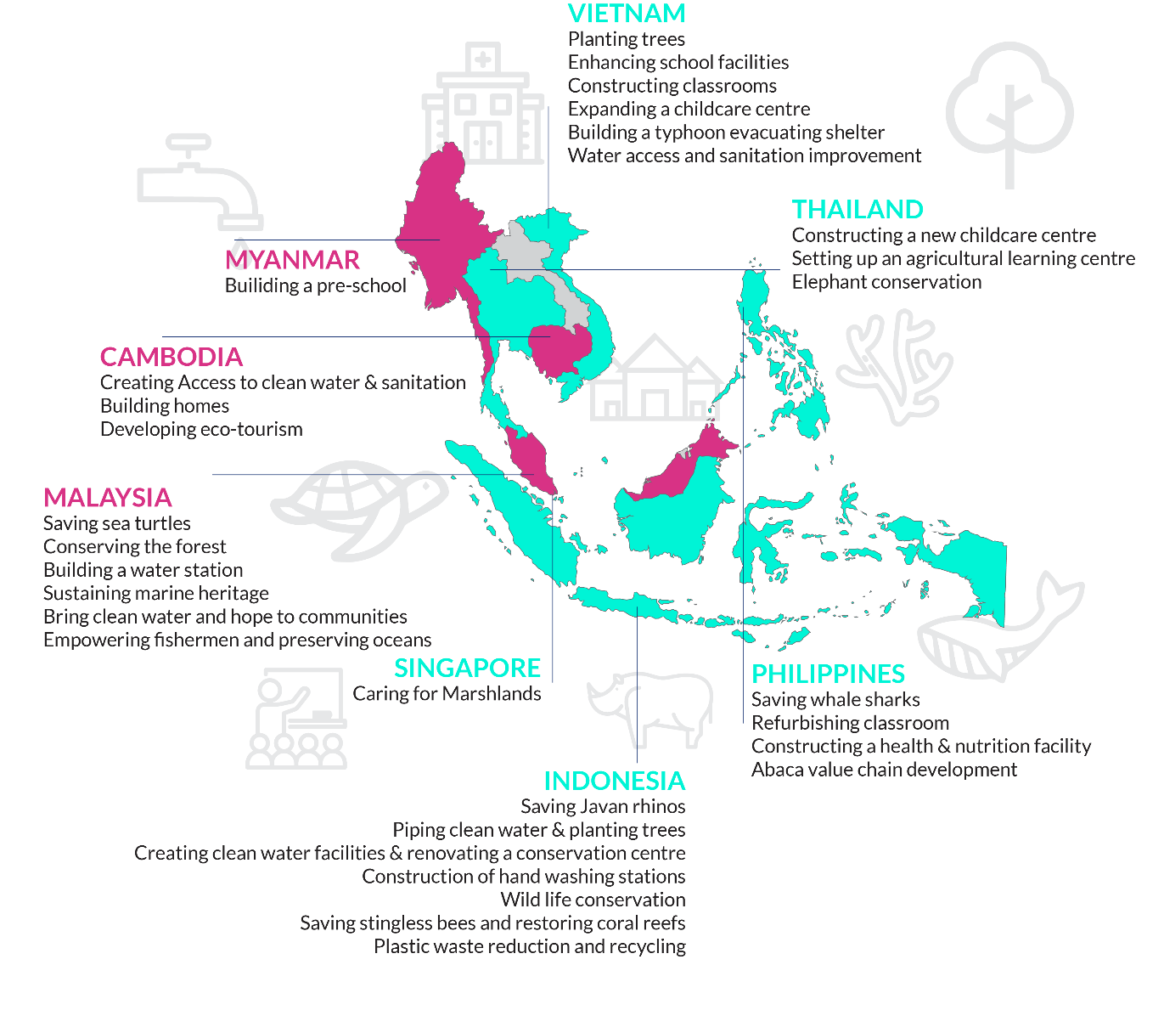
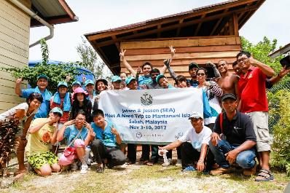

SOCIAL RESPONSIBILITY
‘Meet a Need’ Programme
  Combines corporate volunteering with funding for projects that meet specific social or environmental needs in the ASEAN region
  500+ employees since 2007
  28,000+ hours spent volunteering
  >30 communities
  SGD 6 million+ invested by Jebsen & Jessen

Slide 28
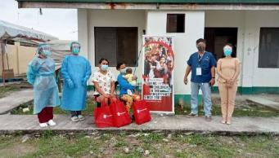
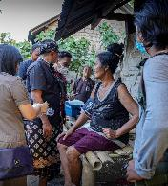
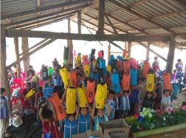
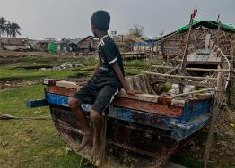


DISASTER RESPONSE
‘Save the Children’ Partnership
  Provides critical support and funding to communities affected by disasters in the ASEAN region
  1,000+ people helped since 2020
  Emergency relief goes to improving mental health, increasing access to COVID-19 vaccines and providing essential supplies to displaced children
Making a difference in the lives of children in disaster-stricken areas of countries like Philippines, Indonesia and Myanmar.

Slide 29
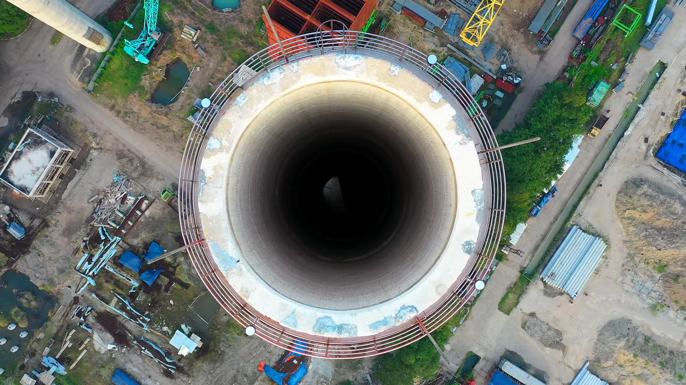
THE
FAMILY ENTERPRISE
Over 130 years of history
THE
FAMILY ENTERPRISE
Over 130 years of history

Slide 30




THE FAMILY ENTERPRISE
Jebsen & Jessen Group
Jebsen & Jessen Hamburg Group
Industrial Engineering • Industrial Garnet • Ingredients •
Material Handling • Mobility, Industry & Beverage •
Packaging • Technology
Australia | Brazil | China | Germany | India | Indonesia | Malaysia | Myanmar | Mongolia | Philippines | Saudi Arabia | Singapore | Thailand | UAE | USA | Vietnam
Chemicals • Garnet • Industrial Services • Textiles
Canada | Colombia | Denmark | Ecuador | France | Germany | Panama | Switzerland | United Kingdom | USA
Jebsen Group
Triton Textile Group
Consumer • Beverage • Motors • Logistics • Capital
Mainland China | Hong Kong | Macau
Textiles
Bangladesh | Mainland China | Hong Kong
6,000
26
US$ 2.4bn
US$ 4.0bn
people
countries
assets
turnover

Slide 31





GET CONNECTED
Subscribe to ‘The Mackerel’
Follow us!
Jebsen & Jessen Group
@we.are.jj
We are Jebsen & Jessen

Slide 32
THANK YOU

